Slide 1
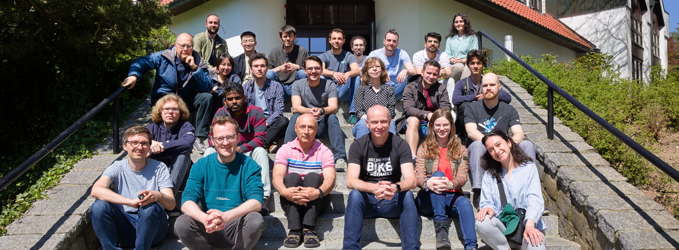
Tiny CNN with microfluidic pipes
Jorge Torres Gómez | Telecommunication Networks

Slide 2
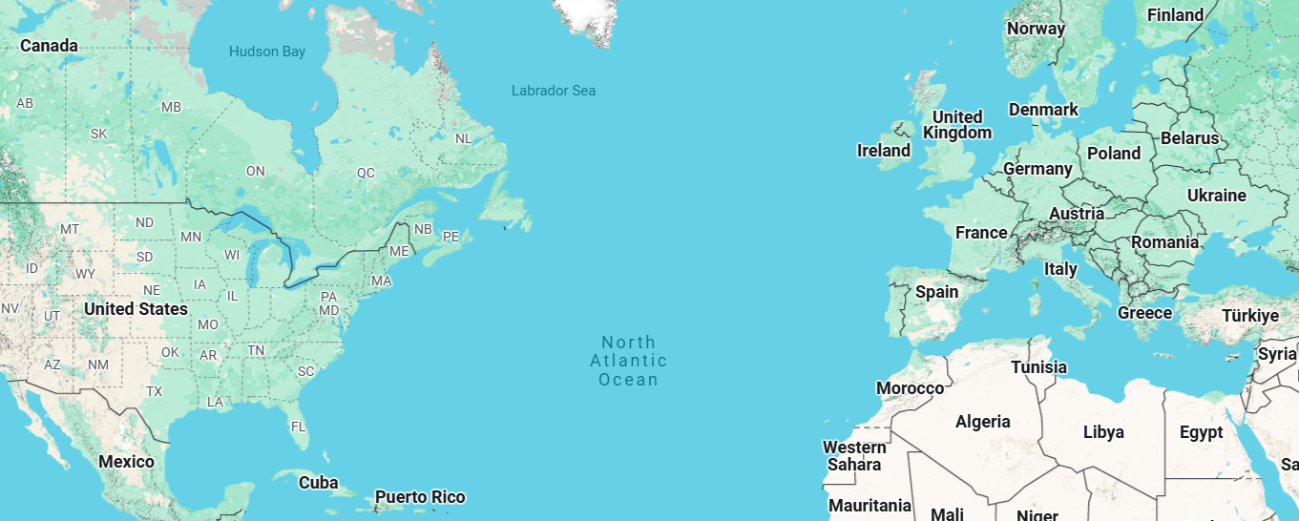

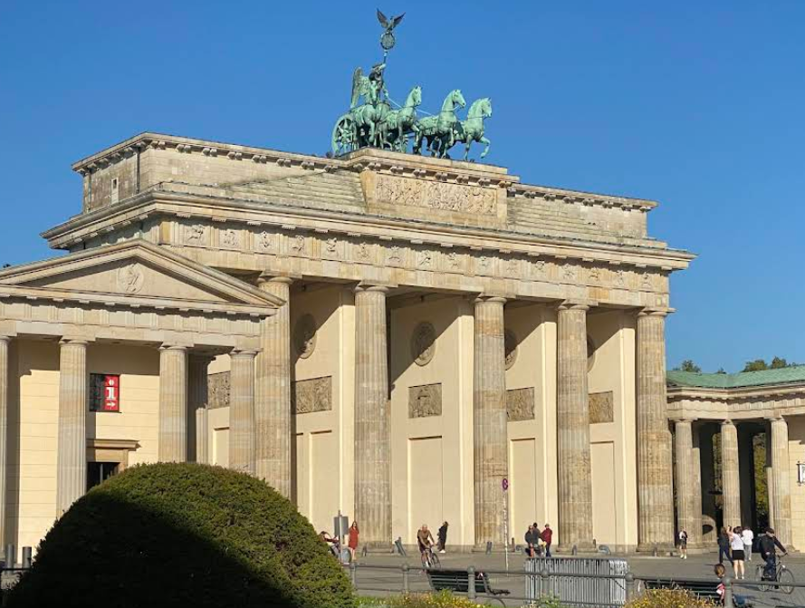




Slide 3
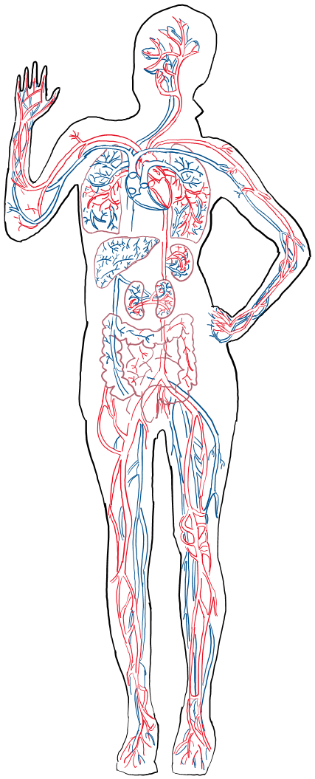





Internet of Bio-Nano-Things
Gateway
Remote
Monitor
nanosensor
Wound

Slide 4
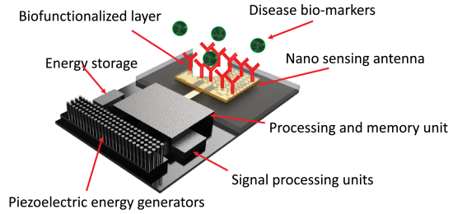
Internet of Bio-Nano-Things
Gateway
Remote
Monitor
nanosensor
Wound
[1] A. Sangwan and J. M. Jornet, "Joint Communication and Bio-Sensing With Plasmonic Nano-Systems to Prevent the Spread of Infectious Diseases in the Internet of Nano-Bio Things," in IEEE Journal on Selected Areas in Communications, vol. 40, no. 11, pp. 3271-3284, Nov. 2022, doi: 10.1109/JSAC.2022.3214288.

Slide 5
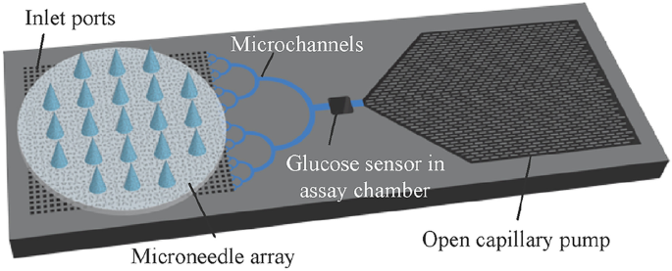

Gateway
Gateway
nanosensor
[1] Takeuchi, K., Takama, N., Sharma, K. et al. Microfluidic chip connected to porous microneedle array for continuous ISF sampling. Drug Deliv. and Transl. Res. 12, 435–443 (2022).

Slide 6
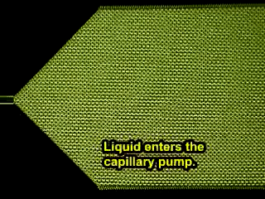
[1] Takeuchi, K., Takama, N., Sharma, K. et al. Microfluidic chip connected to porous microneedle array for continuous ISF sampling. Drug Deliv. and Transl. Res. 12, 435–443 (2022).

Slide 7
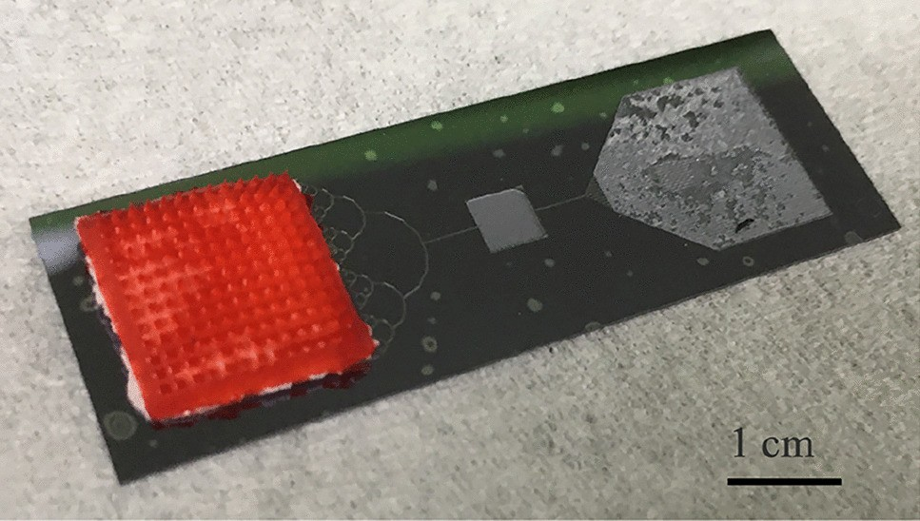
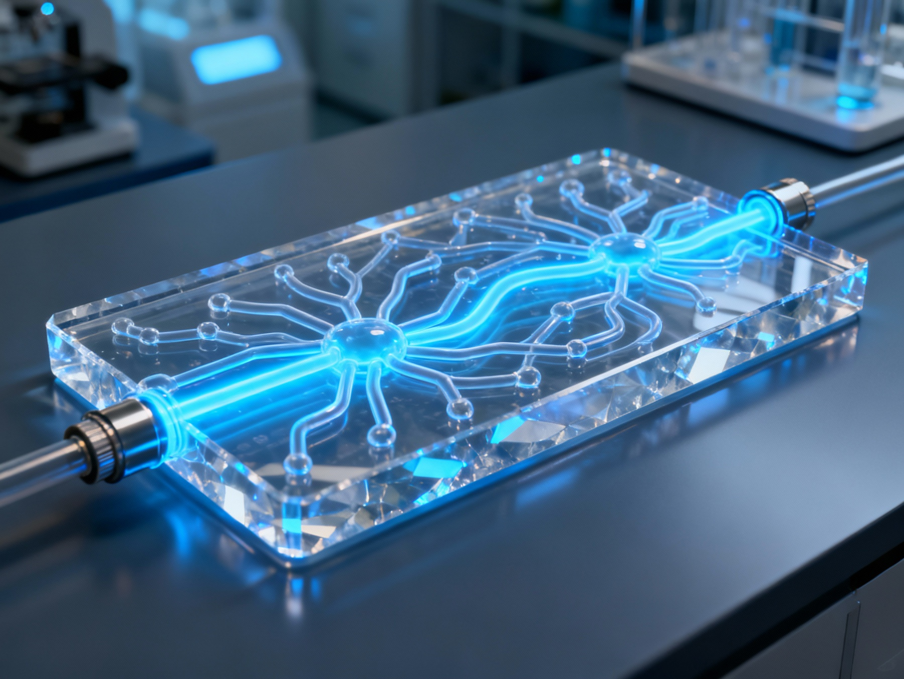
Pump
Microneedles
Neural Network System
[1] Takeuchi, K., Takama, N., Sharma, K. et al. Microfluidic chip connected to porous microneedle array for continuous ISF sampling. Drug Deliv. and Transl. Res. 12, 435–443 (2022).

Slide 8
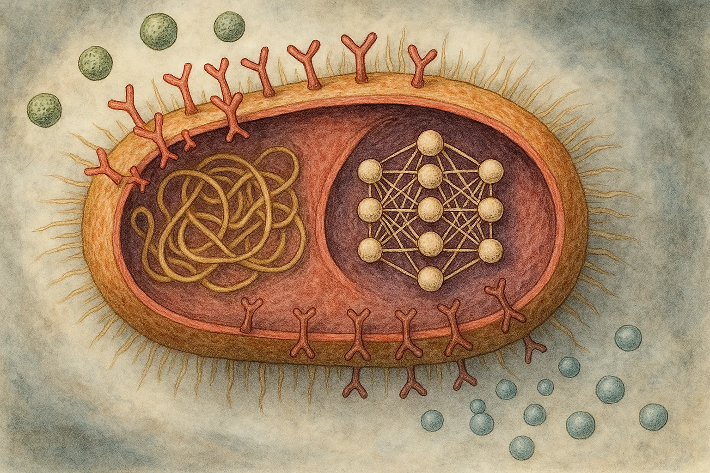
Research Questions
What biological constraints limit the feasibility of running NNs in living cells?
Which NN architectures can realistically be supported under these biological constraints?
How can we implement online training algorithms that adapt to biological environments in real-time?
Notes:
Already smart mechanism within the cell.
Hosting a NN within a cell (prokaryote or eukaryote)?
Complexity level achievable within the cell?
Online training NNs within the cell? (evolutionary concepts)
What are the biological constraints (space and energy)?
Online learning?

Slide 9
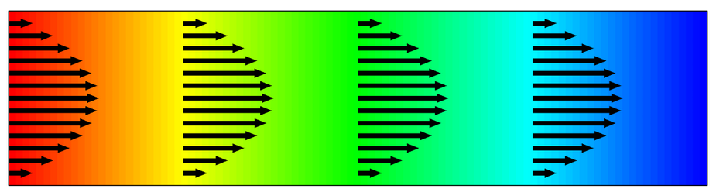

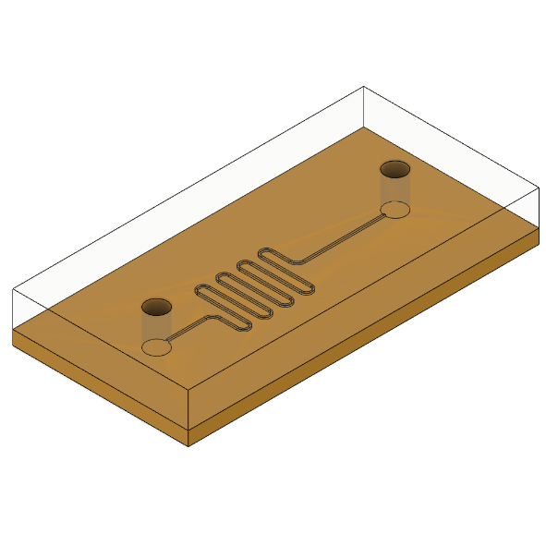
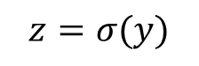
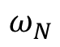
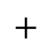
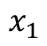

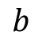
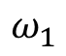
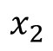
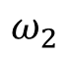
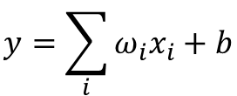
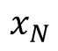
Bio-Computing
Single Neuron Scheme
$$b$$
Activation
Function
$$x_{1}$$
$$ω_{N}$$
$$y=\sum_{i}{ω_{i}x_{i}}+b$$
$$x_{2}$$
$$ω_{2}$$
$$+$$
$$z=σ(y)$$
$$⋯$$
$$x_{N}$$
$$ω_{1}$$
Transport of Diluted Species
Chemical
Reaction
[1] A. O. Bicen and I. F. Akyildiz, “System-Theoretic Analysis and Least-Squares Design of Microfluidic Channels for Flow-Induced Molecular Communication,” IEEE Transactions on Signal Processing, vol. 61, no. 20, pp. 5000–5013, Oct. 2013, doi: 10.1109/TSP.2013.2274959.
Microfluidic Circuit
9

Slide 10
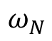
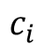
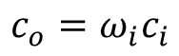
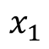
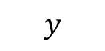
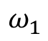
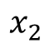
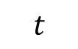
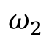
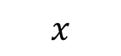
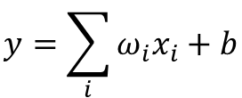
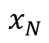
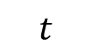
Concept
Single Neuron Scheme
$$b$$
Activation
Function
$$x_{1}$$
$$ω_{N}$$
$$y=\sum_{i}{ω_{i}x_{i}}+b$$
$$x_{2}$$
$$ω_{2}$$
$$+$$
$$z=σ(y)$$
$$⋯$$
$$x_{N}$$
$$ω_{1}$$
$$y$$
Transport of Diluted Species
Inlet
Outlet
$$x$$
$$c_{i}$$
$$c_{o}=ω_{i}c_{i}$$
$$t$$
$$t$$
10

Slide 11
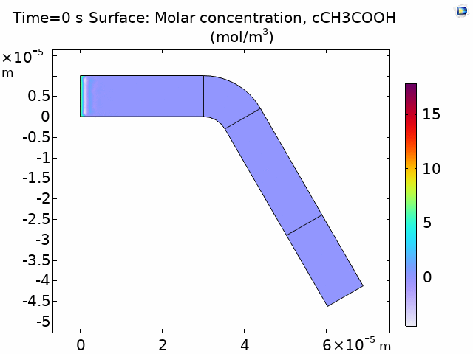

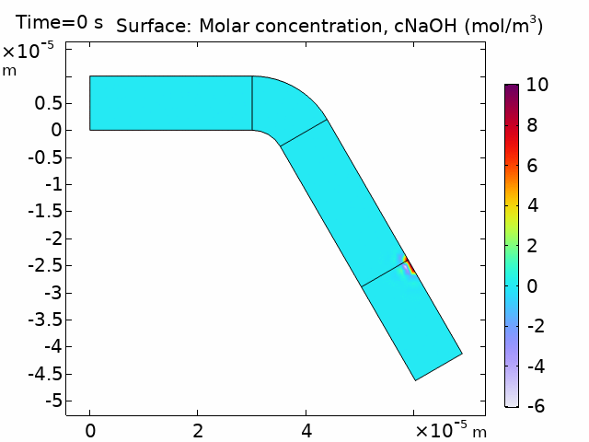

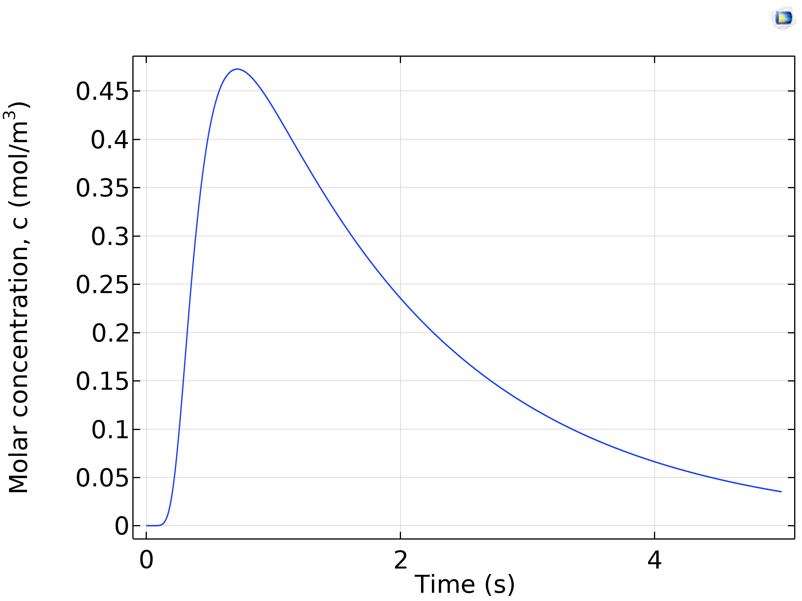
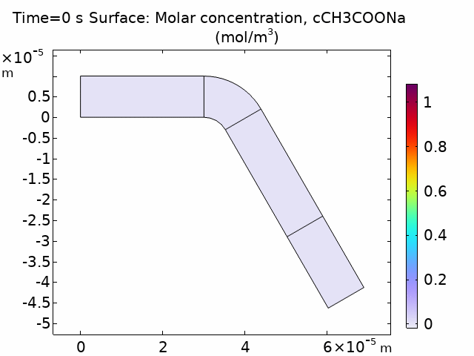
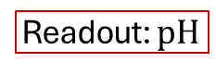
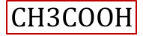
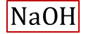
Concept
Activation
Function
$$NaOH$$
$$CH3COOH$$
$$NaOH+CH3COOH →CH3COONa+H2O$$
Readout: $pH$
11

Slide 12

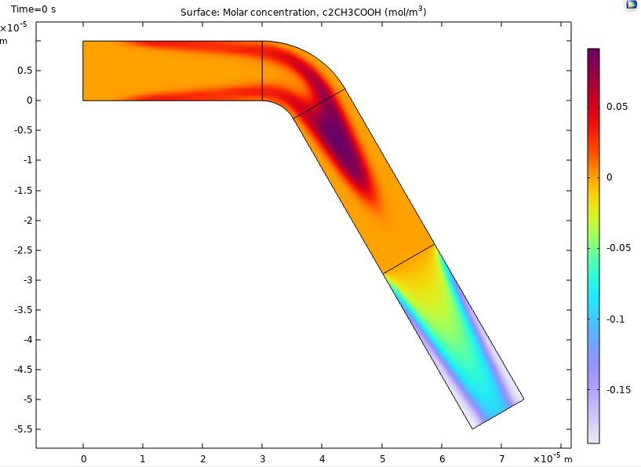
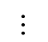
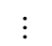
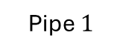
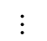
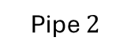
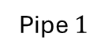
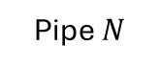


Concept
Single Neuron Scheme
Pipe $N$
$$⋯$$
Pipe $2$
Inlets
Inlet B
Pipe $1$
Outlet
Chemical Reactor
Combiner
CNN-like Scheme
Pipe $N$
$$⋯$$
$$⋯$$
Inlet B
Pipe $2$
Inlet A
Outlet
Pipe $1$
Chemical Reactor
Splitter
Combiner
12

Slide 13







Concept
COMSOL Simulations
CNN-like Scheme
Pipe $N$
$$⋯$$
$$⋯$$
Inlet B
Pipe $2$
Inlet A
Outlet
Pipe $1$
Chemical Reactor
Splitter
Combiner
13

Slide 14

Concept
COMSOL Simulations
CNN-like Scheme
Pipe $N$
$$⋯$$
$$⋯$$
Inlet B
Pipe $2$
Inlet A
Outlet
Pipe $1$
Chemical Reactor
Splitter
Combiner
14

Slide 15



















Synthesis
CNN-like Scheme
Pipe $2$
$$Q_{2}$$
Pipe $1$
Define the sampling time on Pipe 1
$$∆P$$
$$Q_{1}$$
$$L_{1}$$
$$w_{1}$$
Outlet
$$c\left(L,t\right)=\frac{1}{2}C_{0}\text{erfc}\frac{L_{1}−v_{\text{char}}t}{2\sqrt{D_{\text{eff}} t}}$$
$$\sqrt{48}≪\text{Pe}≪4\frac{L}{r}$$
$$Q_{3}$$
Pipe $3$
$$h(t)=\frac{∂}{∂t}c\left(L,t\right){\left.​\right|}_{C_{0}=1}$$
Peclet number condition
Parameter | Value
$h$ | $50 μm$
$∆P$ | $600$ Pa
$D$ Tartrazine | $4.9∙{10}^{−10} [m^{2}/s]$
$$v_{\text{char}}=\overline{v}=\frac{Q_{1}}{w_{1}h}$$
$$Q_{1}=\frac{∆P }{R_{1}}$$
$$R_{1}=\frac{12μL_{1}}{1−0.63h/w_{1}}\frac{1}{h^{3}w_{1}}$$
$$\text{Pe}=\frac{h^{2}v_{\text{char}}}{D}$$
$$D_{\text{eff}}=D\left(1+1/200 {\text{Pe}}^{2}\right)$$
15

Slide 16









Synthesis
Parameter | Value
$h$ | $50 μm$
$∆P$ | $600$ Pa
$D$ Tartrazine | $4.9∙{10}^{−10} [m^{2}/s]$
CNN-like Scheme
Pipe $2$
$$Q_{2}$$
Pipe $1$
Define the sampling time on Pipe 1
$$∆P$$
$$Q_{1}$$
$$L_{1}$$
$$w_{1}$$
Outlet
$$c\left(L,t\right)=\frac{1}{2}C_{0}\text{erfc}\frac{L_{1}−v_{\text{char}}t}{2\sqrt{D_{\text{eff}} t}}$$
$$\sqrt{48}≪\text{Pe}≪4\frac{L}{r}$$
(1)
$$Q_{3}$$
Pipe $3$
$$h(t)=\frac{∂}{∂t}c\left(L_{1},t\right){\left.​\right|}_{C_{0}=1}$$
(2)
$$v_{\text{char}}=\overline{v}=\frac{Q_{1}}{w_{1}h}$$
(3)
$$Q_{1}=\frac{∆P }{R_{1}}$$
(4)
$$R_{1}=\frac{12μL_{1}}{1−0.63h/w_{1}}\frac{1}{h^{3}w_{1}}$$
(5)
$$\text{Pe}=\frac{h^{2}v_{\text{char}}}{D}$$
(6)
16
$$D_{\text{eff}}=D\left(1+1/200 {\text{Pe}}^{2}\right)$$
(7)

Slide 17












Synthesis
CNN-like Scheme
Pipe $2$
$$Q_{2}$$
Pipe $1$
Define the sampling time on Pipe 1
$$∆P$$
$$Q_{1}$$
$$L_{1}$$
$$w_{1}$$
Outlet
$$c\left(L,t\right)=\frac{1}{2}C_{0}\text{erfc}\frac{L_{1}−v_{\text{char}}t}{2\sqrt{D_{\text{eff}} t}}$$
$$\sqrt{48}≪\text{Pe}≪4\frac{L}{r}$$
(1)
$$Q_{3}$$
Pipe $3$
$$h(t)=\frac{∂}{∂t}c\left(L_{1},t\right){\left.​\right|}_{C_{0}=1}$$
(2)
Parameter | Value
$h$ | $38 μm$
$∆P$ | $600$ Pa
$D$ Tartrazine | $4.9∙{10}^{−10} [m^{2}/s]$
$$τ=\frac{L_{1}}{v_{\text{char}}}−\frac{2D_{\text{eff}}}{v_{\text{char}}}$$
(3)
Pipe $3$
$$v_{\text{char}}=\overline{v}=\frac{Q_{1}}{w_{1}h}$$
(4)
Pipe $2$
$$Q_{1}=\frac{∆P }{R_{1}}$$
$$R_{1}=\frac{12μL_{1}}{1−0.63h/w_{1}}\frac{1}{h^{3}w_{1}}$$
(5)
(6)
Pipe $1$
$$\text{Pe}=\frac{h^{2}v_{\text{char}}}{D}$$
(7)
$$D_{\text{eff}}=D\left(1+1/200 {\text{Pe}}^{2}\right)$$
(8)
17

Slide 18

















Synthesis
Parameter | Value
$h$ | $30 μm$
$∆P$ | $600$ Pa
$D$ Tartrazine | $4.9∙{10}^{−10} [m^{2}/s]$
CNN-like Scheme
Pipe $2$
Phase 1
2. Evaluate the design in COMSOL
$$Q_{2}$$
Pipe $1$
$$∆P$$
$$Q_{1}$$
$$L_{1}$$
$$w_{1}$$
Outlet
$$τ=\frac{L}{v_{\text{char}}}−\frac{2D_{\text{eff}}}{v_{\text{char}}}$$
$$Q_{3}$$
(1)
Pipe $3$
18

Slide 19


Synthesis
CNN-like Scheme
Pipe $2$
$$Q_{2}$$
Pipe $1$
Phase 2
3. Find the correction
4. Re-design in COMSOL
$$∆P$$
$$Q_{1}$$
$$L_{1}$$
$$w_{1}$$
Outlet
$$Q_{3}$$
Pipe $3$
$$∆τ→∆L$$
$$∆τ=\frac{∆L}{v_{\text{char}}}−\frac{2D_{\text{eff}}}{v_{\text{char}}}$$
(1)
19

Slide 20



Synthesis
CNN-like Scheme
Parameter | Value
$h$ | $38 μm$
$∆P$ | $600$ Pa
$D$ Tartrazine | $4.9∙{10}^{−10} [m^{2}/s]$
Pipe $2$
$$Q_{2}$$
Pipe $1$
3. Find the correction
4. Re-design in COMSOL
$$∆P$$
$$Q_{1}$$
$$L_{1}$$
$$w_{1}$$
Outlet
$$Q_{3}$$
Pipe $3$
20

Slide 21
Experiment 1: Design 1.1
Design 1.1
Pipe 2
Pipe 1
Purpose
Validate the synchronization of pulses through the three different pipes.
Architecture
Transmitter + CNN
Dimensions
Total size: 4.8 x 2.9 cm
Chemicals
Tartrazine and H2O
Study phase
Theoretical calculations completed
Simulation in COMSOL completed
Experimental validation is missing
Pipe 3

Slide 22





Experiment Design
Experiment 3
NaOH, CH₃COOH
Experiments 1 & 2
(Tartrazine)
CNN-like Scheme
Pipe $3$
Transmitter
500 μm to 1 mm
Inlet B
$$⋯$$
Pipe $2$
Communication Channel
Inlet C
Inlet A
Outlet B
Pipe $1$
Outlet A
Experiment 4
NaOH, CH₃COOH

Slide 23

Experiment 1: Design 1.1
Purpose
Validate the synchronization of pulses through the three different pipes.
Architecture
Transmitter + CNN
Dimensions
Total size: 4.8 x 2.6 cm
Chemicals
Tartrazine and H2O
Study phase
Theoretical calculations completed
Simulation in COMSOL completed
Experimental validation is missing

Slide 24

Experiment 1: Design 1.1 & 1.2
Design 1.1
Purpose
Validate the synchronization of pulses through the three different pipes.
Architecture
Transmitter + CNN
Dimensions
Total size: 4.8 x 2.6 cm
Chemicals
Tartrazine and H2O
Study phase
Theoretical calculations completed
Simulation in COMSOL completed
Experimental validation is missing
$$∆τ→∆L$$
Design 1.1
Design 1.2

Slide 25




Experiment 2: Design 2
Pipe $3$
Design 2
Inlet B
$$⋯$$
Pipe $2$
Purpose:
To validate the synchronization of pulses and expected amplitudes through the three different pipes.
Components:
Transmitter+CNN
Chemicals:
NaOH
CH₃COOH
Study phase
Missing the theoretical calculations of the size for the Outlet C
Missing simulation in COMSOL.
Pipe $1$
Inlet A
Outlet B
Outlet A
Inlet C
Outlet C

Slide 26


Experiment 2: Design 2
Pipe $3$
Design 2
Inlet B
$$⋯$$
Pipe $2$
Pipe $1$
Inlet A
Outlet B
Outlet A
Inlet C
Outlet C
Phase 1
Phase 2

Slide 27


Experiment 3: Design 3
Purpose:
Caracterize the sensor regarding ist sensitivity.
Components:
Transmitter + Sensor
Chemicals:
NaOH
CH₃COOH
H₂O
Study phase
Missing the theoretical calculations of the size for the Outlet C
Missing simulation in COMSOL.
$$NaOH+CH3COOH →CH3COONa+H2O$$

Slide 28

Experiment 4: Design 4
Purpose:
To validate the complete system.
Components:
Transmitter+CNN+Sensor
Chemicals:
NaOH
CH3COOH
H2O
Study phase
Missing the theoretical calculations of the size for the Outlet C
Missing simulation in COMSOL.

Slide 29
Tiny CNN with microfluidic pipes
Jorge Torres Gómez | Telecommunication Networks

Slide 30
Experiment 1: Design 1.1
Design 1.1
Pipe 2
Pipe 1
Purpose
Validate the synchronization of pulses through the three different pipes.
Architecture
Transmitter + CNN
Dimensions
Total size: 4.8 x 2.9 cm
Chemicals
Tartrazine and H2O
Study phase
Theoretical calculations completed
Simulation in COMSOL completed
Experimental validation is missing
Pipe 3

Slide 31




glucose
concentration
Single Neuron Scheme
Pipe $N$
$$⋯$$
Pipe $2$
Inlets
Inlet B
Pipe $1$
Outlet
Chemical Reactor
Combiner
time
serial-to-parallel
converter

Slide 32


























Analysis
$$y$$
$$y_{ro}$$
Derivative of the Step-response
$$c(x_{0},t)$$
$$r_{out}$$
$$c(x_{1},t)$$
$$r_{in}$$
$$c(x_{2},t)$$
$$x$$
(1)
$$l$$
$$φ$$
$$c_{r}(x_{ro},t)$$
(2)
O
$$x_{ro}$$
$${\overline{c}}_{r}(x_{ro},y_{ro},t)$$
(3)
$$y$$
$$c(x_{0},t)$$
$$c(x_{1},t)$$
$$c(x_{2},t)$$
$$l$$
(4)
(5)
$$x$$
(6)
32

Slide 33














Analysis
$$y$$
$$y_{ro}$$
$$r_{in}$$
$$r_{out}$$
$$c(x_{1},t)$$
$$c(x_{2},t)$$
$$c(x_{0},t)$$
$$x$$
$$l$$
Derivative of the Step-response
$$φ$$
$$c_{r}(x_{ro},t)$$
O
(1)
$$x_{ro}$$
$$x_{ro}$$
(2)
33

Slide 34








Analysis
$$y$$
$$y_{ro}$$
$$r_{in}$$
$$r_{out}$$
$$c(x_{1},t)$$
$$c(x_{2},t)$$
Derivative of the Step-response
$$x$$
$$c(x_{0},t)$$
$$l$$
$$φ$$
$$c_{r}(x_{ro},t)$$
(1)
O
$$x_{ro}$$
$φ=\frac{π}{3}$ $r=20$ μm
$L=3$ mm $r=20$ μm
$L=3$ mm $φ=\frac{π}{3}$
34

Slide 35







Application
CNN-like Scheme
Pipe $N$
$$⋯$$
500 μm to 1 mm
Inlet B
$$⋯$$
Inlet C
Communication Channel
Pipe $2$
Inlet A
Outlet
Pipe $1$
Outlet
Definitions
Chemical Element.
Fluid element.
Pressure.
Size of pipes.
Design of the electronic components
[1] M. M. Albay, E. Akyol, F. Mirlou, L. Beker, and M. Kuscu, “Low-cost Microfluidic Testbed for Molecular Communications with Integrated Hydrodynamic Gating and Screen-printed Sensors,” Jan. 31, 2025, arXiv: arXiv:2501.19341. doi: 10.48550/arXiv.2501.19341.
35

Slide 36










Application
$3×5$ cm
CNN-like Scheme
Pipe $3$
Transmitter
1mm to 4 mm
Inlet B
$$⋯$$
Pipe $2$
Communication Channel
Inlet C
Inlet A
Outlet B
Pipe $1$
Outlet A
Time to fill-in
$∆t={V_{L}}/{Q_{min}}$
$∆t= {2πr^{2}×{heigth}_{max}}/{Q_{min}}$
Flow max
$Q=0.5−7$ μl/min
Height
$\text{10−}\text{50}$ μm
Width: minimum
$\text{5}\text{0}\text{−500}$ μm
NaOH
$$r=50 \text{μ}\text{m}$$ | $$Q=1.89 \text{μ}\text{l}\text{/}\text{min}$$ | $T_{b}=5$ s | $∆t=635$ ms | $≈12\%$
$$r=100 \text{μ}\text{m}$$ | $Q=6.9$ μl/min | $T_{b}=4$ s | $∆t=410$ ms | $≈10\%$
$$r=250 \text{μ}\text{m}$$ | $Q=2.4$ μl/min | $T_{b}=5$ s | $∆t=1.17$s | $≈30\%$
36

Slide 37





Application
$3×5$ cm
CNN-like Scheme
Pipe $3$
Transmitter
500 μm to 1 mm
Inlet B
$$⋯$$
Pipe $2$
Communication Channel
Inlet C
Inlet A
Outlet B
Pipe $1$
Outlet A
37

Slide 38






















Design 1.0
$$P_{u32}$$
$$P_{b32}$$
$$P_{u22}$$
Pipe $3$
$$⋯$$
$$P_{u31}$$
$$P_{b22}$$
Pipe $2$
$$P_{u0}$$
$$P_{u33}$$
$$P_{u11}$$
$$P_{b31}$$
$$P_{u21}$$
$$P_{b21}$$
$$P_{b23}$$
$$P_{u23}$$
$$P_{b33}$$
Pipe $1$
$$P_{b0}$$
$$P_{b12}$$
$$P_{b13}$$
$$P_{b11}$$
38

Slide 39

Design 1.0
39

Slide 40




Design 2
Pipe $3$
Inlet B
$$⋯$$
Pipe $2$
Pipe $1$
Inlet A
Outlet B
Outlet A
Inlet C
Outlet C
40

Slide 41
Design 3
Chemical Reactor
Inlet B
Inlet C
Inlet A
Outlet B
Outlet A
41

Slide 42




Design 4
CNN-like Scheme
Pipe $3$
Transmitter
Communication Channel
Chemical Reactor
Inlet B
$$⋯$$
Pipe $2$
Inlet C
Pipe $1$
Inlet A
Outlet B
Outlet A
Outlet C
42

Slide 43

Application
Pipe $3$
Inlet B
$$⋯$$
Pipe $2$
Inlet C
Inlet A
Outlet B
Pipe $1$
Outlet A
43

Slide 44
Application
CNN-like Scheme
Pipe $N$
$$⋯$$
500 μm to 1 mm
Inlet B
$$⋯$$
Inlet C
Communication Channel
Pipe $2$
Inlet A
Outlet
Pipe $1$
Outlet
44

Slide 45
Application
$3×5$ cm
CNN-like Scheme
Pipe $3$
Transmitter
500 μm to 1 mm
Inlet B
$$⋯$$
Pipe $2$
Communication Channel
Inlet C
Inlet A
Outlet B
Pipe $1$
Outlet A
45

Slide 46

















Synthesis
Pipe $2$
Pipe $3$
Pipe $3$
Pipe $1$
Inlet B
$$⋯$$
Pipe $2$
Inlet C
Inlet A
Outlet B
Pipe $1$
Outlet A
NaOH
Radius: $r∈50−70$ μm
Pipe $3$
Pipe $2$
Pipe $1$
Pipe $2$
Pipe $3$
Pipe $1$
46

Slide 47








Synthesis
Pipe $2$
Pipe $3$
Pipe $3$
Pipe $1$
Inlet B
$$⋯$$
Pipe $2$
Inlet C
Inlet A
Outlet B
Pipe $1$
Outlet A
NaOH
Radius: $r∈50−70$ μm
Pipe $1$
Pipe $2, L_{1}=16.5$ mm
Pipe $3, L_{1}=16.5 \text{mm}$
47

Slide 48



Synthesis
Pipe $2$
Pipe $3$
Pipe $3$
Pipe $1$
Inlet B
$$⋯$$
Pipe $2$
Inlet C
Inlet A
Outlet B
Pipe $1$
Outlet A
NaOH
Radius: $r∈120−150$ μm
Pipe $1$
Pipe $2$
Pipe $2$
Pipe $3$
Pipe $1$
Pipe $3$
48

Slide 49




Synthesis
Pipe $2$
Pipe $3$
Pipe $3$
Pipe $1$
Inlet B
$$⋯$$
Pipe $2$
Inlet C
Inlet A
Outlet B
Pipe $1$
Outlet A
NaOH
Radius: $r∈100−120$ μm
Pipe $1$
Pipe $2, L_{1}=16.5$ mm
Pipe $3, L_{1}=16.5 \text{mm}$
49

Slide 50














Synthesis
Pipe $2$
Pipe $3$
Pipe $2$
Pipe $1$
Inlet B
$$⋯$$
Pipe $2$
Inlet C
Inlet A
Outlet B
Pipe $1$
Outlet A
NaOH
Radius: $r∈250−270$ μm
Pipe $2$
Pipe $3$
Pipe $2$
Pipe $3$
Pipe $1$
Pipe $1$
50

Slide 51







Synthesis
Pipe $2$
Pipe $3$
Pipe $2$
Pipe $1$
Inlet B
$$⋯$$
Pipe $2$
Inlet C
Inlet A
Outlet B
Pipe $1$
Outlet A
NaOH
Radius: $r∈250−270$ μm
51

Slide 52







Synthesis
Pipe $2$
Pipe $3$
Pipe $2$
Pipe $1$
Inlet B
$$⋯$$
Pipe $2$
Inlet C
Inlet A
Outlet B
Pipe $1$
Outlet A
NaOH
Radius: $r∈250−270$ μm
Pipe $1$
Pipe $2, L_{1}=28.3$ mm
Pipe $3, L_{1}=28.3 \text{mm}$
52

Slide 53













Synthesis
Pipe $3$
Inlet B
$$⋯$$
Pipe $2$
Inlet A
Outlet B
Pipe $1$
Outlet A
Tartrazine
Radius: $r∈250−270$ μm
Pipe $1$
Pipe $2$
Pipe $3$
Pipe $3$
Pipe $2$
Pipe $1$
53

Slide 54






Synthesis
Pipe $2$
Pipe $3$
Pipe $2$
Pipe $1$
Inlet B
$$⋯$$
Pipe $2$
Inlet A
Outlet B
Pipe $1$
Outlet A
Tartrazine
Radius: $r∈100−120$ μm
Pipe $1$
Pipe $2, L_{1}=26.6$ mm
Pipe $3, L_{1}=26.6 \text{mm}$
54

Slide 55









Synthesis
CNN-like Scheme
Pipe $N$
$$⋯$$
$$⋯$$
Inlet B
Pipe $2$
Inlet A
Outlet
Pipe $1$
Chemical Reactor
Splitter
Combiner
Design constraints
(1)
(2)
(3)
55

Slide 56







Synthesis
CNN-like Scheme
Pipe $N$
$$⋯$$
$$⋯$$
Inlet B
Pipe $2$
Inlet A
Outlet
Pipe $1$
Chemical Reactor
Splitter
Combiner
56

Slide 57


Synthesis
CNN-like Scheme
Design constraints
Pipe $N$
(1)
$$⋯$$
$$⋯$$
Inlet B
Pipe $2$
(2)
Inlet A
Outlet
Pipe $1$
Chemical Reactor
Splitter
Combiner
(3)
57

Slide 58


Synthesis
CNN-like Scheme
Design constraints
Pipe $N$
(1)
$$⋯$$
$$⋯$$
Inlet B
Pipe $2$
(2)
Inlet A
Outlet
Pipe $1$
Chemical Reactor
Splitter
Combiner
(3)
58

Slide 59

Synthesis
CNN-like Scheme
Pipe $N$
$$NaOH+CH3COOH →CH3COONa+H2O$$
$$⋯$$
$$⋯$$
Inlet B
Pipe $2$
Inlet A
Outlet
Pipe $1$
Chemical Reactor
Splitter
Combiner
59

Slide 60


Bio-Computing
Digital Computing
Chemical Reaction Networks
DSP
Microfluidic Chips
60

Slide 61





Linear Component: $ω_{i}∙x_{i}$
$$ω_{1}$$
$$ω_{2}$$
61

Slide 62

Bio-Computing
Analog Computing
Wet-Neuromorphic Computing
Chemical Reaction Networks
Compartment Based
Models
Reservoir Computing
J. Perera et al., “Wet-Neuromorphic Computing: A New Paradigm for Biological Artificial Intelligence,” IEEE Intelligent Systems, pp. 1–7, 2025. DOI: 10.1109/mis.2025.3555551.

Slide 63

Bio-Computing
Analog Computing
Wet-Neuromorphic Computing
Chemical Reaction Networks
Compartment Based
Models
Reservoir Computing
J. Perera et al., “Wet-Neuromorphic Computing: A New Paradigm for Biological Artificial Intelligence,” IEEE Intelligent Systems, pp. 1–7, 2025. DOI: 10.1109/mis.2025.3555551.

Slide 64


Bio-Computing
Analog Computing
Wet-Neuromorphic Computing
Chemical Reaction Networks
Compartment Based
Models
Reservoir Computing
J. Perera et al., “Wet-Neuromorphic Computing: A New Paradigm for Biological Artificial Intelligence,” IEEE Intelligent Systems, pp. 1–7, 2025. DOI: 10.1109/mis.2025.3555551.

Slide 65

Bio-Computing
[1] S. Balasubramaniam, S. Somathilaka, S. Sun, A. Ratwatte, and M. Pierobon, “Realizing Molecular Machine Learning Through Communications for Biological AI,” IEEE Nanotechnology Magazine, vol. 17, no. 3, pp. 10–20, Jun. 2023, doi: 10.1109/MNANO.2023.3262099.

Slide 66

Bio-Computing
Digital Computing
Chemical Reaction Networks
DSP
Microfluidic Chips
Analog Computing
Wet-Neuromorphic Computing
Chemical Reaction Networks
Compartment Based Models
Reservoir Computing
$\sim 300$ learnable parameters

Slide 67

Datasets
67

Slide 68
Communicating Smartly at the Nanoscale - Neural Networks Developments in Molecular Communication
Jorge Torres Gómez | Telecommunication Networks

Slide 69
nanoAI Lab: A new research group
Jorge Torres Gómez | Telecommunication Networks

Slide 70



Research groups in our Network
General Purpose AI for IoBNT Applications
Micro-fluidic circuits
Werner Haselmayr
Ozgur Baris Akan
H. Birkan Yilmaz
Functionalized Graphene
Ozgur Baris Akan

Slide 71





Grant programs: National
Discovery Grants
Address higher-risk (higher reward) topics.
Discovery Horizons/Alliance Society
Investigator-initiated individual and team projects.
Interdisciplinary research.
Exploration
Competition-based
Interdisciplinary research.
Promote relevant collaborations across disciplines, professions, and sectors.

Slide 72



Grant programs: International
International
Competition based
Four years funding
Funding for one year to initiate international research collaborations
International Partners:
Turkey (Koc Uni., Bogazici Uni.)
Germany (TU Berlin, TU Dresden, TU Darmstadt, Erlangen)
Norway (Oslo University Hospital)
Sweeden (Uppsala University)
Spain (Polytechnic University of Barcelona)
Italy (University of Milano)
US (Northeastern University, Michigan University, Nebraska)
Join and lead consortium projects among 3 countries at least (EU+Canada)

Slide 73


NanoAI Lab: MOU Network
Deciphering Gene Regulation in Bacteria
Lourdes Pena-Castillo
Computer Science
https://www.cs.mun.ca/~lourdes/public/index.html
Signaling Mechanisms in Cell Survival and Cell Growth
Dr. Brian E. Staveley, Ph.D.
Department of Biology
https://www.mun.ca/biology/bstaveley/
Peptide-Induced Reorganization of Lipid Assemblies
M. R. Morrow
Department of Physics
https://www.physics.mun.ca/~mmorrow/
Hierarchical Materials
Erika Merschrod
Department of Chemistry
https://www.merschrod.group/team.html
Electronic sensor platform

Slide 74
Understanding SeMeCo: Yeast Metabolic Teamwork
Falko Dressler | Telecommunication Networks

